Slide 1
Outline
Lex:
    Theory.
    Execution.
    Example.
Yacc:
    Theory.
    Description.
    Example.
Lex & Yacc linking.
LEX and YACC
1

Slide 2
Lex
lex is a program (generator) that generates lexical analyzers, (widely used on Unix).
It is mostly used with Yacc parser generator.
Written by Eric Schmidt and Mike Lesk.
It reads the input stream (specifying the lexical analyzer ) and outputs source code implementing the lexical analyzer in the C programming language.
Lex will read patterns (regular expressions); then produces C code for a lexical analyzer that scans for identifiers.
LEX and YACC

Slide 3
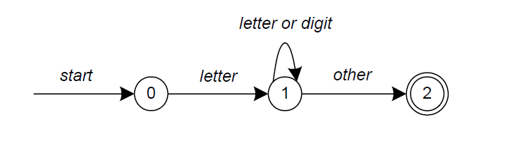
Lex
  A simple pattern: letter(letter|digit)*
Regular expressions are translated by lex to a computer program that mimics an FSA.
This pattern matches a string of characters that begins with a single letter followed by zero or more letters or digits.
LEX and YACC

Slide 4
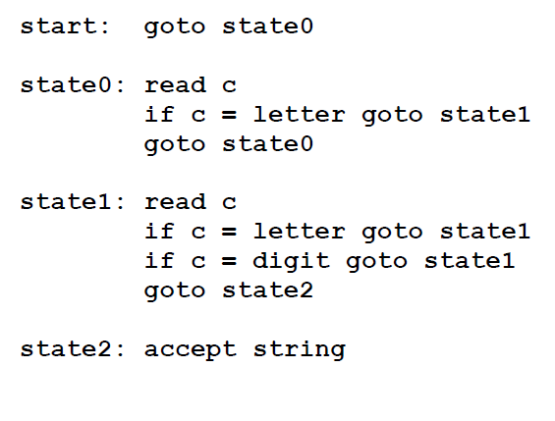
Lex
Some limitations, Lex cannot be used to recognize nested structures such as parentheses, since it only has states and transitions between states.
So, Lex is good at pattern matching, while Yacc is for more challenging tasks.
LEX and YACC

Slide 5
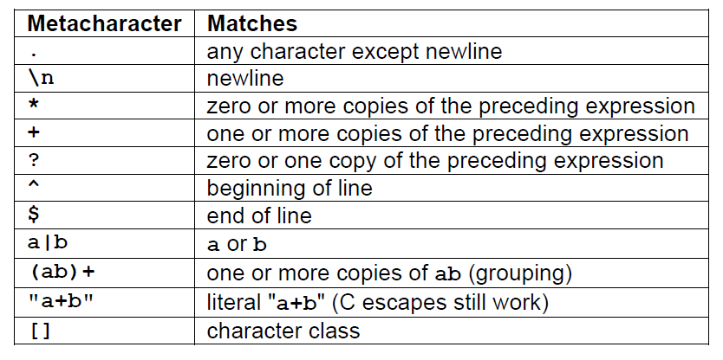
Lex
Pattern Matching Primitives
LEX and YACC

Slide 6
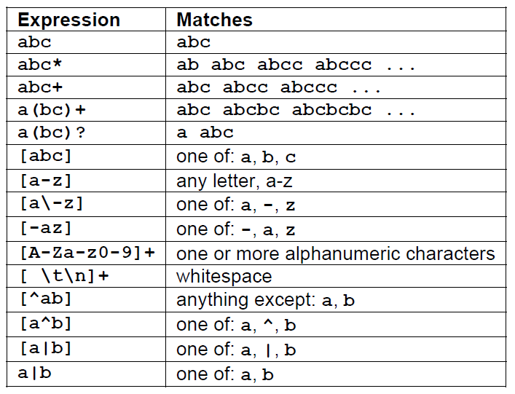
Lex
Pattern Matching examples.
LEX and YACC

Slide 7
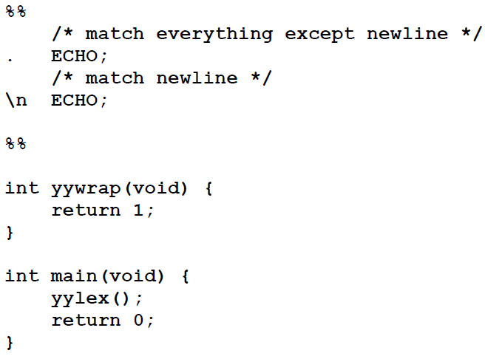
Lex
……..Definitions section……
%%
……Rules section……..
%%
……….C code section (subroutines)……..
The input structure to Lex.
Echo is an action and predefined macro in lex that writes code matched by the pattern.
LEX and YACC

Slide 8
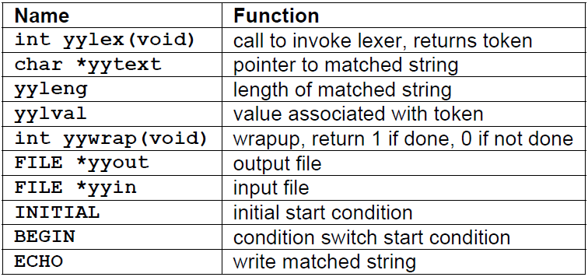
Lex
Lex predefined variables.
LEX and YACC

Slide 9
How to run LEX program
lex first.l
gcc lex.yy.c
./a.out
gcc lex.yy.c -ll -ly
LEX and YACC

Slide 10
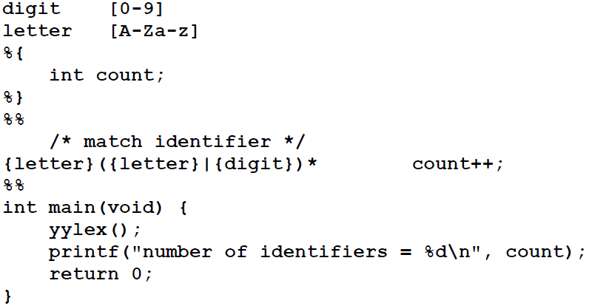
LEX program to count number of identifiers
Whitespace must separate the defining term and the associated expression.
Code in the definitions section is simply copied as-is to the top of the generated C file and must be bracketed with “%{“ and “%}” markers.
substitutions in the rules section are surrounded by braces ({letter}) to distinguish them from literals.
LEX and YACC

Slide 11
digit [0-9]
letter [A-Za-z]
%{
int count;
%}
%%
/* match identifier */
{letter}({letter}|{digit})* count++;
%%
int main(void) {
printf("\nEnter the string.. at end press ^d\n");
yylex();
printf("number of identifiers = %d\n", count);
return 0;
}
/* How to Compile:
1. Save the file with .l extention. E.g. vowels.l
2. lex vowels.l -ll -ly
3. gcc -o objfile lex.yy.c
4. ./objfile*/
LEX and YACC

Slide 12
LEX Program to find umber of lines, words, letters,
capital letters, numbers special characters and
total characters
%{
#include<stdio.h>
int lines=0, words=0,s_letters=0,
c_letters=0, num=0, spl_char=0,total=0;
%}
%%
\n { lines++; words++;}
[\t ' ']+ words++;
[A-Z] c_letters++;
[a-z] s_letters++;
[0-9] num++;
. spl_char++;
%%
LEX and YACC

Slide 13
main(void)
{
yyin= fopen("s.txt","r");
yylex();
total=s_letters+c_letters+num+ spl_char;
printf("\n\t%d lines", lines);
printf("\n\t%d words",words);
printf("\n\t%d small letters", s_letters);
printf("\n\t%d capital letters",c_letters);
printf("\n\t%d digits", num);
printf("\n\t%d special characters",spl_char);
printf("\n\tIn total %d characters.\n",total);
}
LEX and YACC

Slide 14
Write a Lex program to count the number of vowels and consonants in a given string
%{
#include<stdio.h>
int vowels=0;
int cons=0;
%}
%%
[aeiouAEIOU] {vowels++;}
[a-zA-Z] {cons++;}
%%
int yywrap()
{
return 1;
}
main()
{
printf("\nEnter the string.. at end press ^d\n");
yylex();
printf("\nNo of vowels=%d\n” ,vowels);
Printf(“\nNo of consonants=%d\n", cons);
}
LEX and YACC

Slide 15
Yacc
Theory:
  Yacc reads the grammar and generate C code for a parser .
  Grammars written in Backus Naur Form (BNF) .
  BNF grammar used to express context-free languages .
  e.g. to parse an expression , do reverse operation( reducing the expression)
  This known as bottom-up or shift-reduce parsing .
  Using stack for storing (LIFO).
LEX and YACC

Slide 16
Yacc
Input to yacc is divided into three sections.
... definitions ...
%%
... rules ...
%%
... subroutines ...
LEX and YACC

Slide 17
Yacc
The definitions section consists of:
  token declarations .
  C code bracketed by “%{“ and “%}”.
  the rules section consists of:
    BNF grammar .
the subroutines section consists of:
  user subroutines .
LEX and YACC

Slide 18
yacc& lex in Together
The grammar:
program -> program expr | ε
expr -> expr + expr | expr * expr | id
Program and expr are nonterminals.
Id are terminals (tokens returned by lex) .
expression may be :
  sum of two expressions .
  product of two expressions .
  Or an identifiers
LEX and YACC

Slide 19
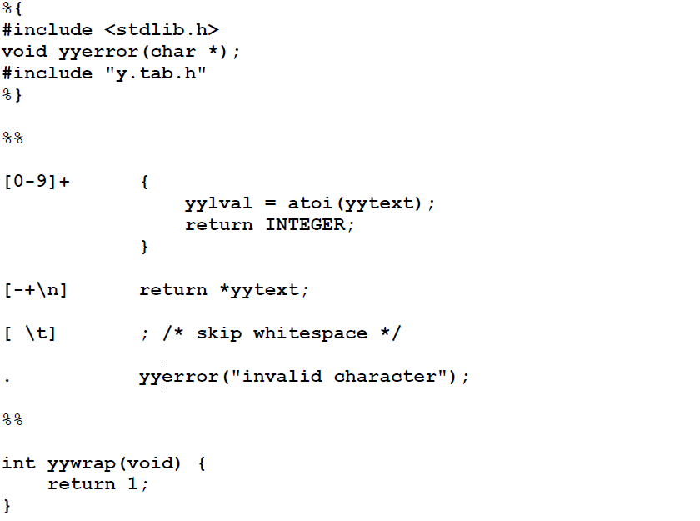
Lex file
LEX and YACC

Slide 20
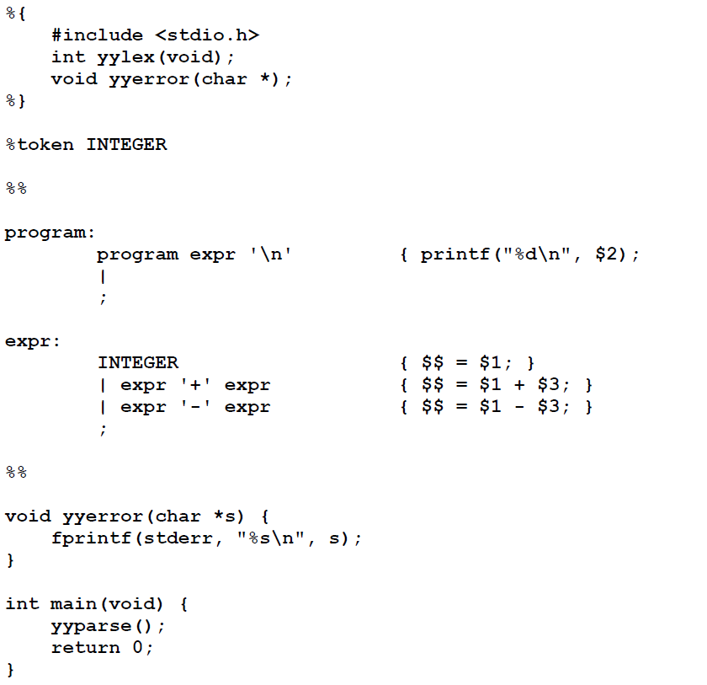
Yacc file
LEX and YACC

Slide 21
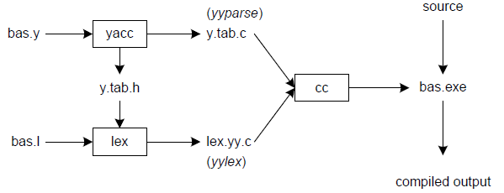
Linking lex&yacc
LEX and YACC

Slide 22
Compiling the example program
To create the desk calculator example program, do the following:
Process the yacc grammar file using the -d optional flag (which informs the yacc command to create a file that defines the tokens used in addition to the C language source code):
yacc -d calc.yacc
2. Use the ls command to verify that the following files were created: y.tab.c The C language source file that the yacc command created for the parser y.tab.h A header file containing define statements for the tokens used by the parser
Process the lex specification file: lex calc.lex
Use the ls command to verify that the following file was created: lex.yy.c The C language source file that the lex command created for the lexical analyzer
LEX and YACC

Slide 23
Compiling the Example Program
To create the desk calculator example program, do the following steps
1. Process the yacc grammar file using the -d optional flag (which informs the yacc command to create a file that defines the tokens used in addition to the C language source code):
yacc -d calc.yacc
2. Use the ls command to verify that the following files were created:
y.tab.c
  The C language source file that the yacc command created for the parser
y.tab.h
  A header file containing define statements for the tokens used by the parser
3. Process the lex specification file:
  lex calc.lex

Slide 24
4. Use the ls command to verify that the following file was created:
lex.yy.c
  The C language source file that the lex command created for the lexical analyzer
5. Compile and link the two C language source files:
cc y.tab.c lex.yy.c
Use the ls command to verify that the following files were created:
y.tab.o
  The object file for the y.tab.c source file
lex.yy.o
  The object file for the lex.yy.c source file
a.out
  The executable program file
To run the program directly from the a.out file, type:
$ a.out
OR
To move the program to a file with a more descriptive name, as in the following example, and run it, type:
$ mv a.out calculate
$ calculate
LEX and YACC

Slide 25
yacc –d calc.y # create y.tab.h, y.tab.c
lex calc.l # create lex.yy.c
cc lex.yy.c y.tab.c –obas.exe # compile/link
LEX and YACC

Slide 26
Conclusions
Yacc and Lex are very helpful for building the compiler front-end
A lot of time is saved when compared to hand-implementation of parser and scanner
They both work as a mixture of “rules” and “C code”
C code is generated and is merged with the rest of the compiler code
LEX and YACC

